Slide 1
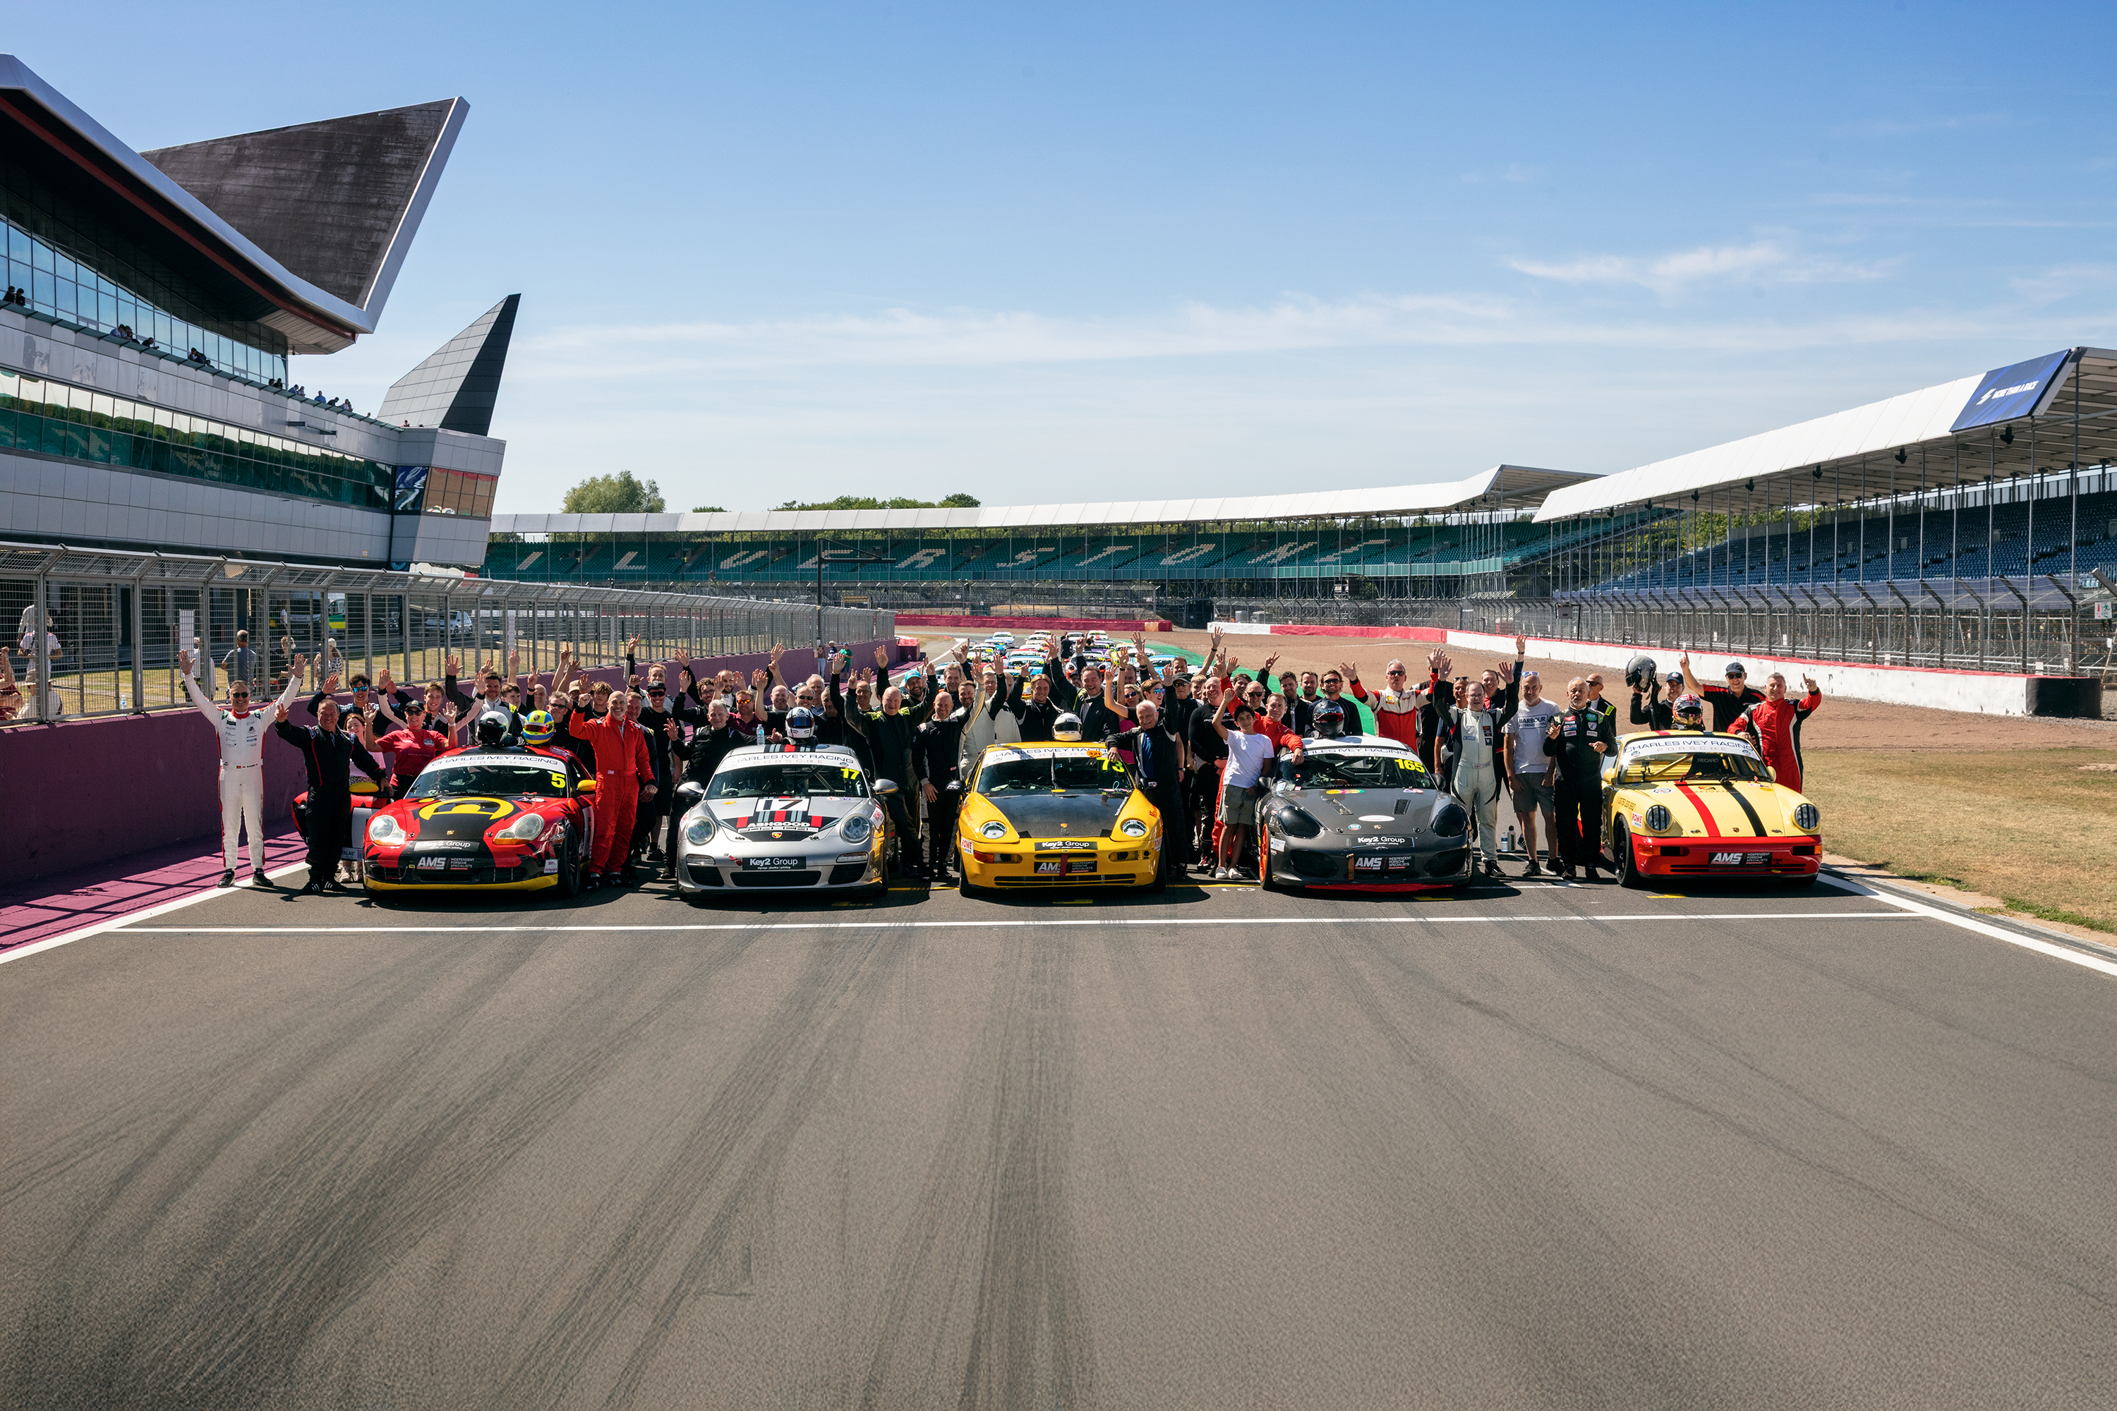

“GREAT RACING
GREAT PEOPLE
GREAT VALUE”
MS
www.allporschetrophy.co.uk.

Slide 2
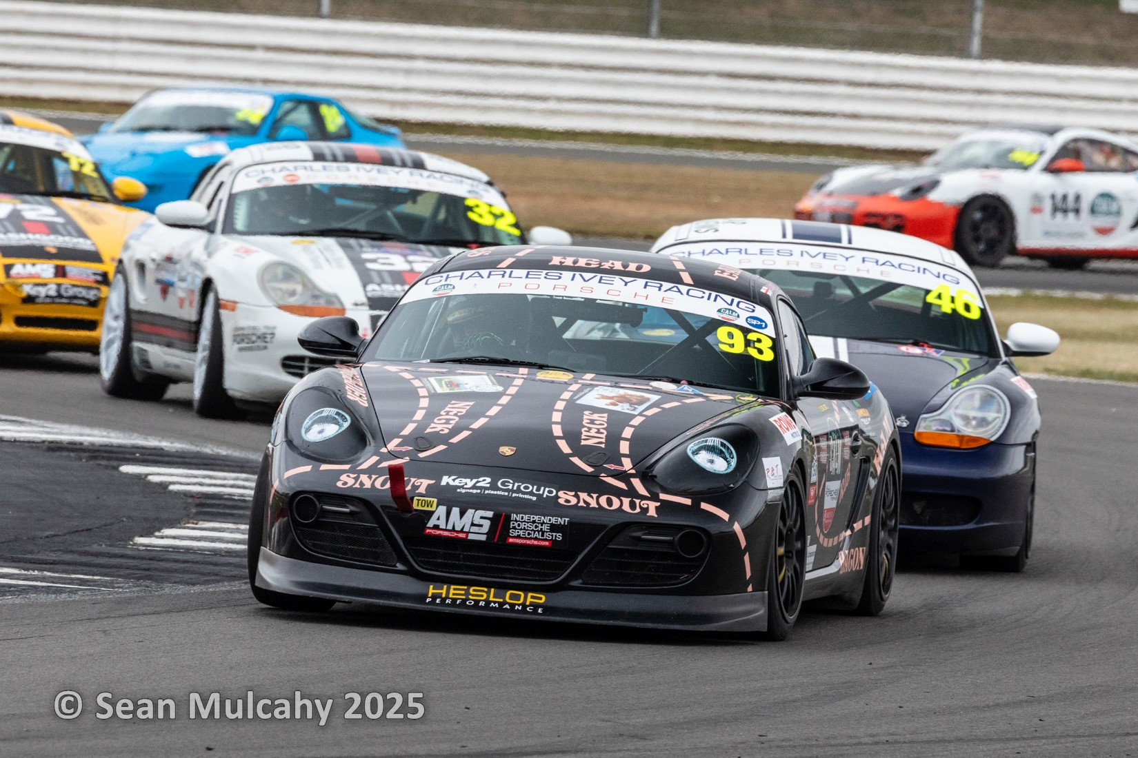
CALM All Porsche Trophy Series (CAP): Affordable and Competitive Motorsport
The CALM All Porsche Trophy Series (CAP) is an innovative and cost-effective motorsport series designed for Porsche enthusiasts. It offers a competitive platform with a focus on close racing, minimal technical regulations, and a friendly paddock atmosphere. This series is structured based on a power-to-weight ratio, allowing various Porsche models to compete, including the 924, 944, 968, Boxster, Cayman, and 911. The series supports CALM (Campaign Against Living Miserably) and is the first UK club racing series to be 100% carbon balanced.
MS

Slide 3
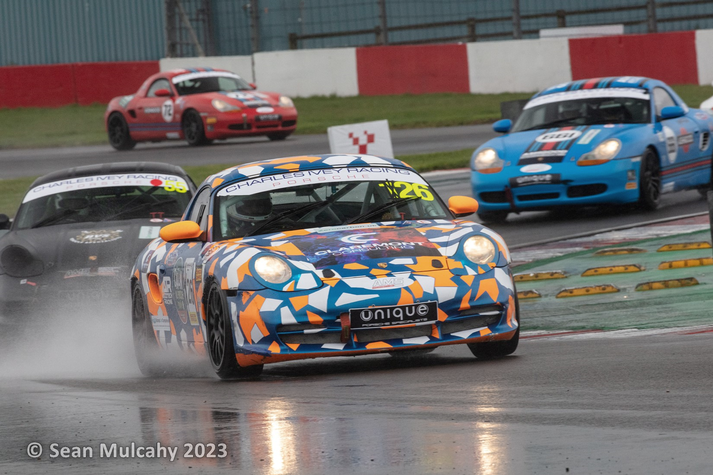

Key Highlights of the CALM All Porsche Trophy Series
Charitable Focus
Carbon Balanced
The series is run in support of CALM (Campaign Against Living Miserably), a charity dedicated to male mental health. All proceeds generated from the series are donated to CALM.
CAP is the first UK club racing series to be 100% carbon balanced, ensuring an environmentally conscious approach to racing.
Race Format
Competitive Balance
The season includes a combination of sprint races and longer endurance events, all of which require a mandatory pit stop. Entries can be made by solo drivers or two-driver teams sharing the same car.
The series promotes close competition by organizing races based on power-to-weight ratios, allowing a diverse range of Porsche models to compete against each other.

Slide 4
2026 Season Calendar: Part 1
Croft
​Apr 11 - Sun, Apr 12, 2026
2 x sprints and 1 x 40 mins (1 or 2 driver race)
Entry fee: £650
Brands Hatch GP
​Sat, Jul 11, 2026
2 x 20 min sprints
Entry fee: £650
1
4
Donington GP
​Sat, May 30, 2026
​2 x sprints
Entry fee: £525
Silverstone lntl
​Sun, Aug 16, 2026
​2 x 20 mins sprint races
Entry fee: £550
2
5
Snetterton 300
​Sat, Jun 20 - Sun, Jun 21, 2026
​2 x sprints and 1 x 40 mins (1 or 2 driver race)
Entry fee: £650
Thruxton
​Sat, Sept 26, 2026
​2 x 20 mins sprint races
Entry fee: £440
3
6
Birkett Relay – Silverstone GP
Sat, Oct 24, 2026
​6 hour team endurance
Entry fee: £TBA
7

Slide 5
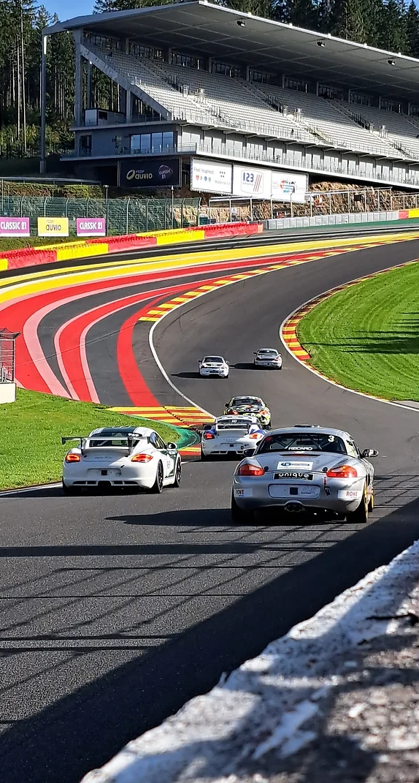
Typical Costings for CALM All Porsche Trophy Series
£5,000
£10,000
924 Preparation
968 Preparation
Approximate cost for preparing a 924 model for racing
Approximate cost for preparing a 968 model for racing
£18,000
£3,200
Boxster/Cayman Preparation
Entry Fees for 2025
Approximate cost for preparing a Boxster or Cayman model for racing
Approximate cost for entry fees for the 2025 season

Slide 6
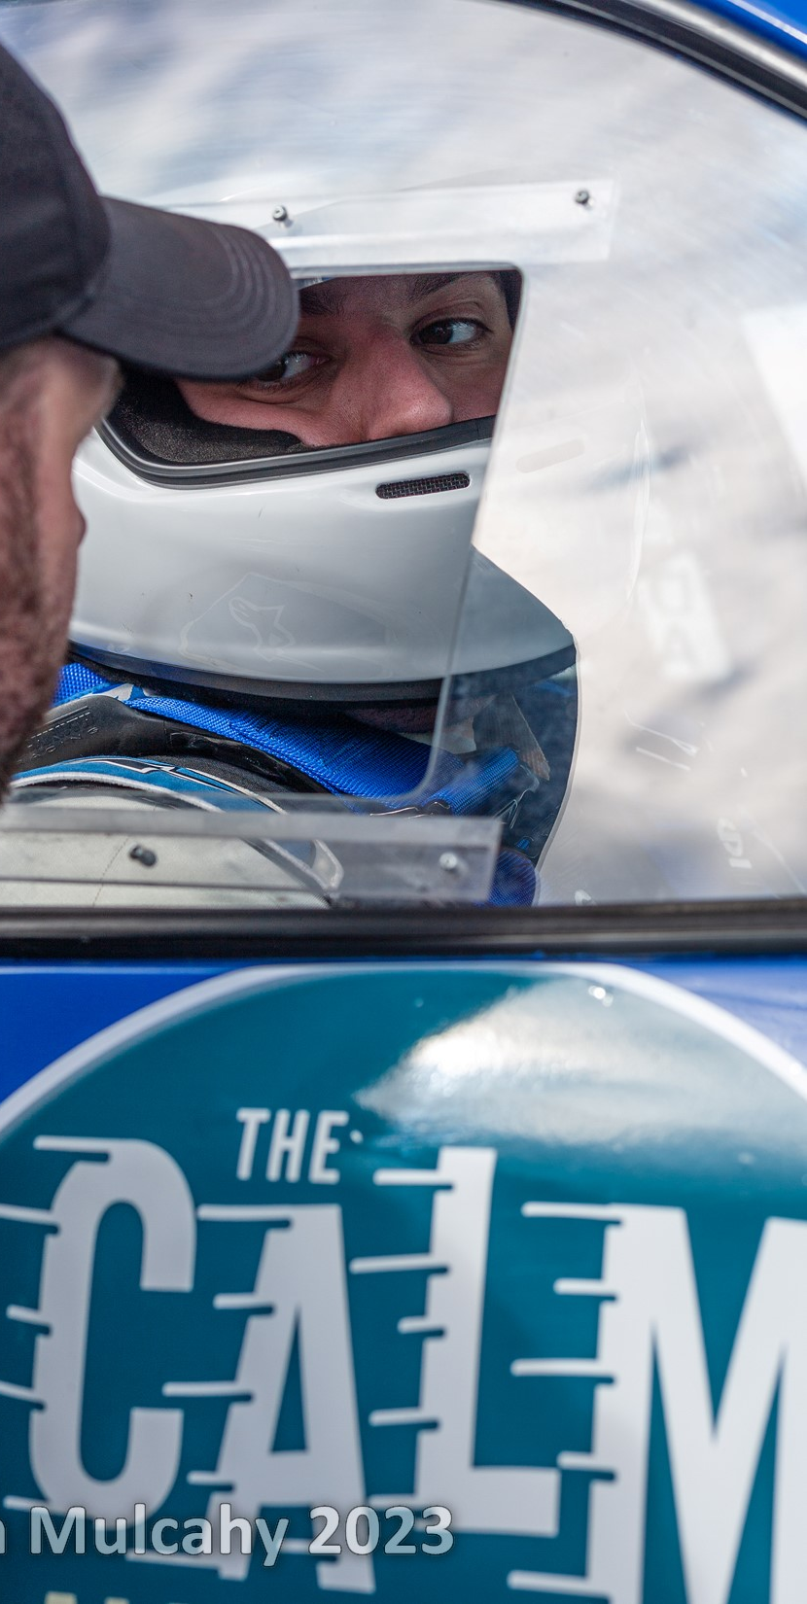

Cost-Effective Features of the Series
No Control Tyres
No Suspension Kits Required
Competitors have the flexibility to choose their preferred tyres, helping to keep costs down.
Participants can use their existing suspension setups, reducing the need for additional expenses.
No Bespoke Parts Required
Flexible Participation
Since the series is not a championship, participants can select the race weekends they wish to compete in, offering a flexible racing schedule.
This ensures that competitors can keep costs down and maintain flexibility with their car setups.

Slide 7
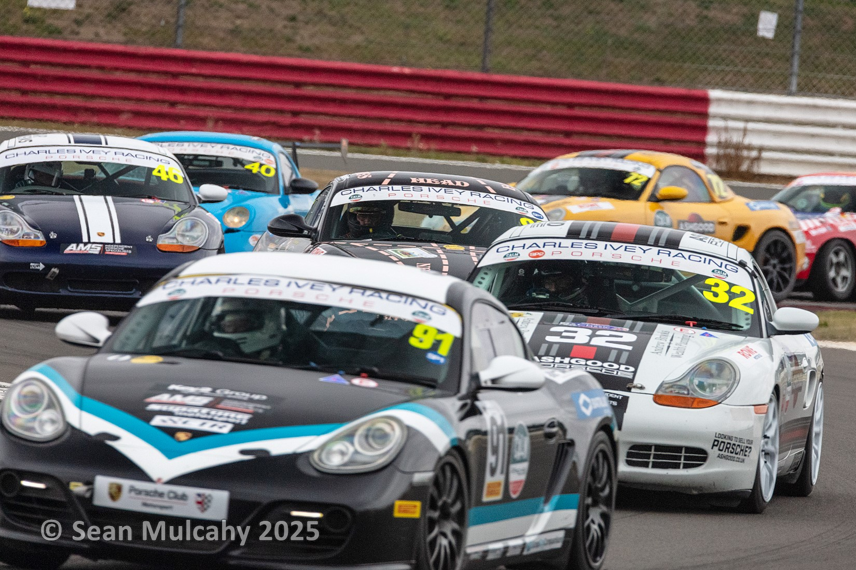
Benefits of Participating in the CALM All Porsche Trophy Series
Affordable Racing
Competitive Platform
Environmentally Conscious
The series is designed to be cost-effective, allowing enthusiasts to participate in motorsport without breaking the bank. With flexible options for car preparation and no requirement for expensive control parts, racers can manage their budgets effectively.
The power-to-weight ratio structure ensures close and exciting racing across a variety of Porsche models. This unique approach allows drivers of different Porsche types to compete on a level playing field, enhancing the overall racing experience.
As the first UK club racing series to be 100% carbon balanced, CAP demonstrates a commitment to environmental responsibility. This feature allows participants to enjoy their passion for racing while minimizing their carbon footprint.

Slide 8
Get Involved in the CALM All Porsche Trophy Series
The CALM All Porsche Trophy Series offers an exciting opportunity for Porsche enthusiasts to participate in competitive motorsport while supporting a worthy cause. With its focus on affordability, competitive balance, and environmental responsibility, the series provides a unique racing experience.
Whether you're a seasoned racer or new to motorsport, the flexible format and variety of Porsche models eligible for participation make this series accessible to a wide range of enthusiasts. The combination of sprint races and endurance events across iconic circuits adds to the appeal and challenge of the series.
For more details on the series and to get involved, visit the official website at www.allporschetrophy.co.uk. Join the CALM All Porsche Trophy Series and be part of an exciting, competitive, and socially responsible motorsport community.

